Slide 1
Common Loss Functions

Slide 2
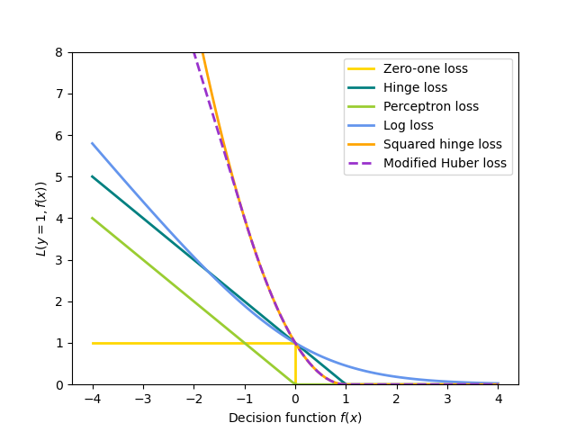
Loss functions
from Scikit-learn

Slide 3
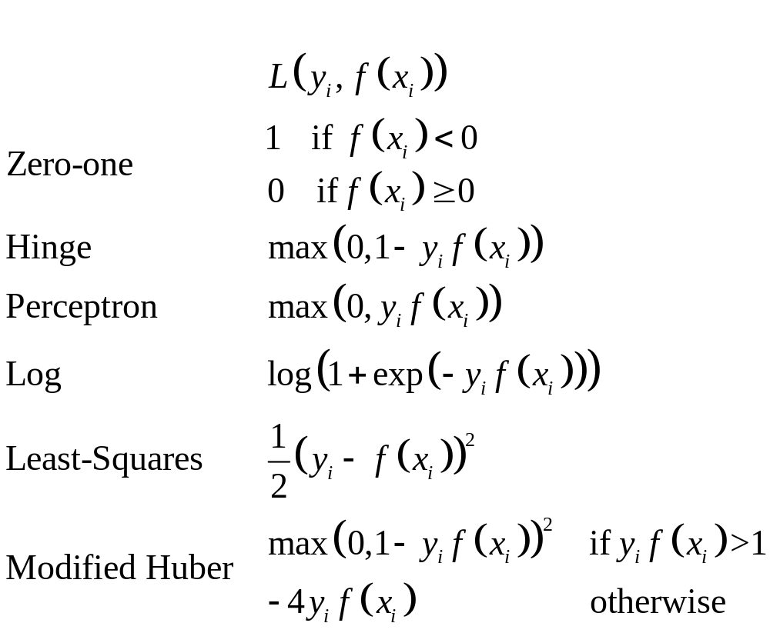
Formulas for common loss functions
from Scikit-learn

